Slide 1

COURSERA CAPSTONE IBM APPLIED DATA SCIENCE CAPSTONE
Setting up a shopping mall in Hyderabad, India
Srija Rallabhandy

Slide 2
Business Problem
Location of the shopping mall is one of the most important decisions that will determine whether the mall will be a success or a failure.
Objective: To analyse and select the best locations in the city of Hyderabad, India to open a new shopping mall.
This project is timely as the city is currently suffering from oversupply of shopping malls.
Business question - In the city of Hyderabad, if a property developer is looking to open a new shopping mall, where would you recommend that they open it?

Slide 3
Data
Data required
List of neighbourhoods in Hyderabad
Latitude and longitude coordinates of the neighbourhoods
Venue data, particularly data related to shopping malls
Sources of data
Wikipedia page for neighbourhoods
(https://en.wikipedia.org/wiki/Category:Neighbourhoods_in_Hyderabad,_India)
Geocoder package for latitude and longitude coordinates
Foursquare API for venue data

Slide 4
Methodology
Web scraping Wikipedia page for neighbourhoods list
Get latitude and longitude coordinates using Geocoder
Use Foursquare API to get venue data
Group data by neighbourhood and taking the mean of the frequency of occurrence of each venue category
Filter venue category by Shopping Mall
Perform clustering on the data by using k-means clustering
Visualize the clusters in a map using Folium

Slide 5
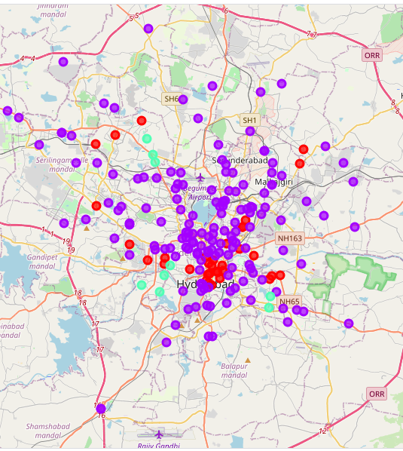
Results
Categorized the neighbourhoods into 3 clusters :
Cluster 0: Neighbourhoods with very less number of shopping malls
Cluster 1: Neighbourhoods with very a moderate concentration of shopping malls
Cluster 2: Neighbourhoods with a high concentration of shopping malls.

Slide 6

Discussion
A good number of shopping malls are concentrated in the central area of the city
Highest number in cluster 2 and moderate number in cluster 1
Cluster 0 has very low number to no shopping mall in the neighbourhoods
Therefore, the project recommends the property developers to capitalize on these findings to open new shopping malls in neighbourhoods in cluster 0 with little or no competition.

Slide 7
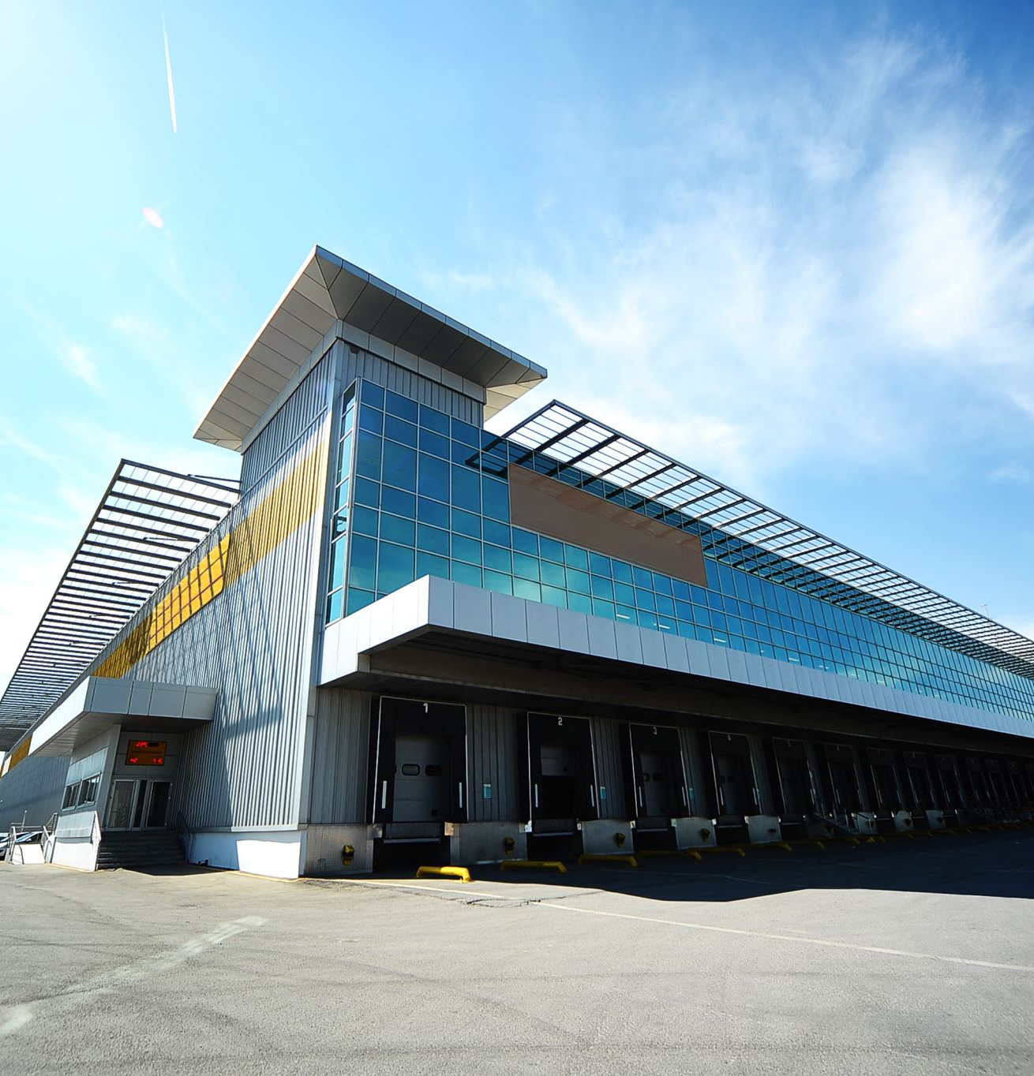
Recommendation and Conclusions
Open new shopping malls in neighbourhoods in cluster 0 with little to no competition
Can also open in neighbourhoods in cluster 1 with moderate competition if have unique selling propositions to stand out from the competition.
Avoid neighbourhoods in cluster 2, already high concentration of shopping malls and intense competition.
Answer to business question: The neighbourhoods in cluster 0 are the most preferred locations to open a new shopping mall
Findings of this project will help the relevant stakeholders to capitalize on the opportunities on high potential locations while avoiding overcrowded areas in their decisions to open a new shopping mall.

Slide 8
Thank you

